Slide 1



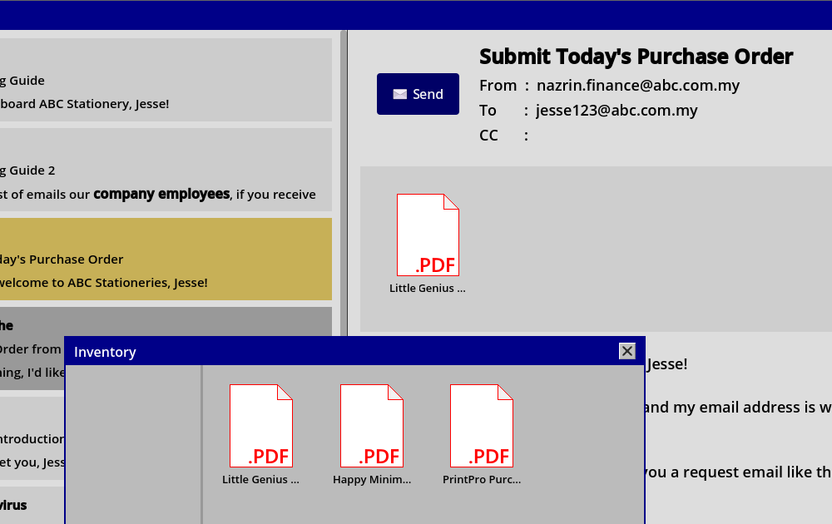
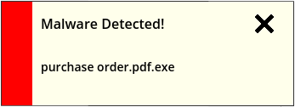











Gamified Cyber Awareness Training
Wong Kai Lun
kai.l.wong@students.plymouth.ac.uk
BSSE2409079@peninsulamalaysia.edu.my
Introduction
Project Objectives & Details
Conclusion
Phishing is the top cyber incident in the fraud category.
With 1160 incidents in months July, August and September 2025 according to MyCERT.
This project aims to increase the general public’s cyber awareness via game as it is more stimulating and entertaining.
User learns better when they have more interaction and feedback. It also helps improve retention.
This game is a place where users can experience what happens if they are not equipped with cyber awareness.
Identify Threats
Current methods of training such as PowerPoint reading and Q&A Forms are insufficient.
Complete Tasks
Explore What Happens

